Slide 1

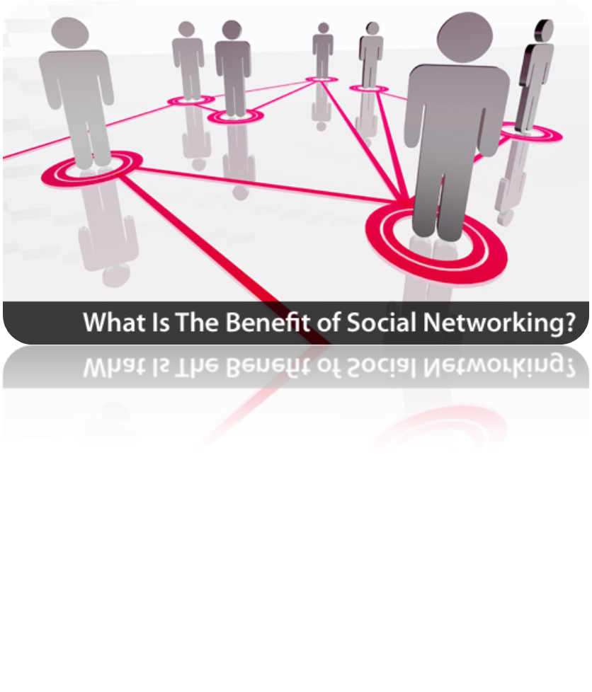

Slide 2



Slide 3

node
Link
node
node
node
node
node
node
node
node
node
node
node
node
node
node
node
node
A set of nodes, points, or locations connected by means of
data, voice, and video communications for the purpose of
exchange.

Slide 4







A social network is a description of the social structure between actors.
Provide social relations
among people, e.g., who share interests and/or activities.
The internet gives individuals from all around the world access to social networking sites.

Slide 5

Most social network services are web based and provide means for users to interact over the internet, such as e-mail and instant messaging.
This means that although you are in the United States, you could develop an online friendship with someone in Denmark or India. Not only will you make new friends, but you just might learn a thing or two about new cultures or new languages and learning is always a good thing.

Slide 6

Anyone can become a member
create groups that share common interests
upload live videos
hold discussions in forums

Slide 7

Information contents created by people.
Using highly accessible publishing technology.
Social media involves
technology
conversations
sharing of information

Slide 8
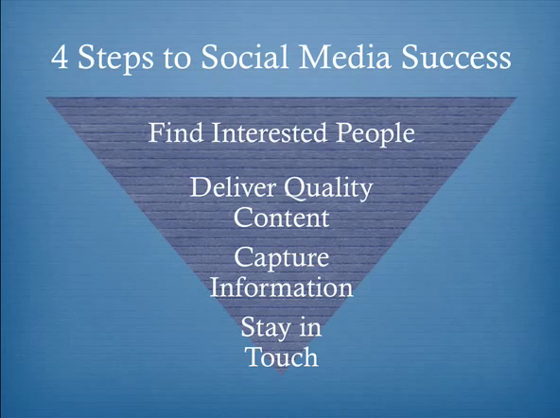

Slide 9


Slide 10

Forums, websites, blogs.
Mailing list, e-groups newsletter/ e-groups.com
Telephone

Slide 11

Having a hard time starting a conversation
People don’t trust you
Anonymous person
Hide ourselves
Avatars and username

Slide 12

To make personal profiles
Shows your identity
Power user
Profile building
Identity building
Self publishing
Community building
Community leader
Contributor
Network building

Slide 13




1995 – YAHOO
1998 – GOOGLE
1999 – NAPSTER
2000 – BLOGGER
2001 – WIKIPEDIA
2002 – FRIENDSTER
2003 – MYSPACE
2004 – FACEBOOK
2005 – YOUTUBE
2006 – TWITTER

Slide 14

There are dangers associated with social networking:
      Data theft and viruses are on the rise.
The most prevalent danger though often involves online predators or individuals who claim to be someone that they are not.

Slide 15


Slide 16

















Slide 17
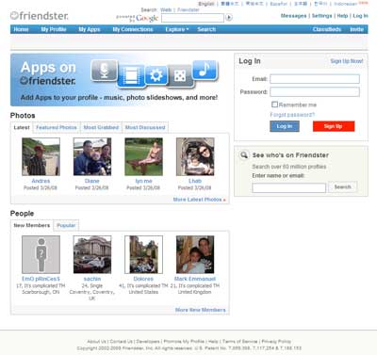

BLOG – WORDPRESS
FAN PROFILE
-Interact
-Testimonials
BULLETIN BOARD
- Announce Events
- Meetings ( Got Club members)
GROUPS
MEET
- WHO VIEWED ME?

Slide 18
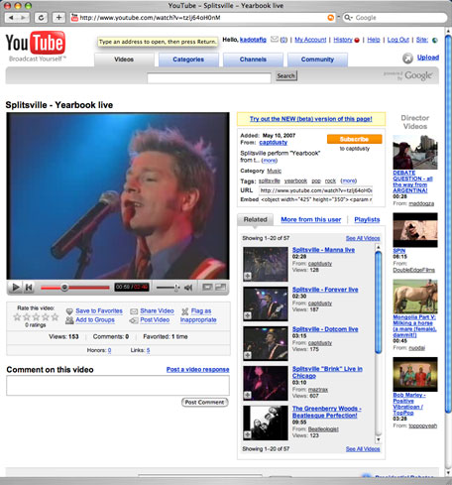

EXTREMELY POPULAR VIDEO PLATFORM.

Slide 19
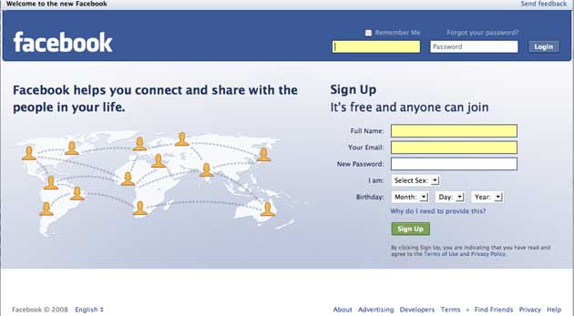

Facebook allows each user to create their own personal profile, in which they can share basic information about themselves.
  home town
  job information
  political and religious views
  Interests, favorite activities, TV, music and more

Slide 20

Pros :
Photo Album: Add photos and photo albums to your Facebook profile.
Blog Merge: Create your own blog , or merge your existing blog right into Facebook's blog
Excellent Search and Browse: Search and browse for people on Facebook
Cons:
No Music: You can not add music to your Facebook profile.
No Video: You also cannot add video to your Facebook profile.
No Chatroom: no general forum so people can get together online and just chat.

Slide 21
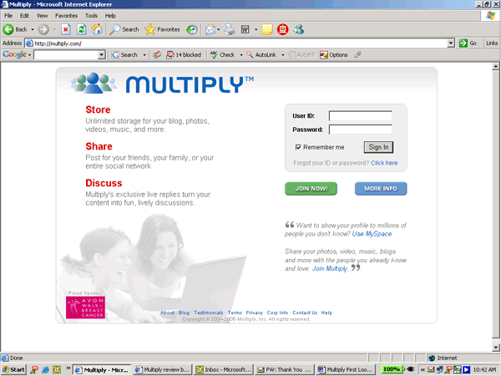

-LOCALLY POPULAR, BLOGGER PLATFORM
-USED AS WEB STORES BLOG AND POSTS.

Slide 22
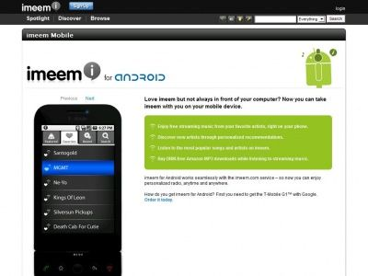

A social media service
To interact by watching, posting, and sharing content of all digital media types, including blogs, photos, audio, and video.

Slide 23
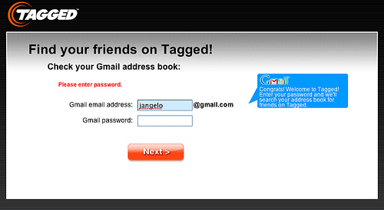

its users to build and customize profiles, send messages, leave comments, post bulletins, customize status, browse photos, watch videos, play games, give gifts, give tags.
Chatting and making friends

Slide 24
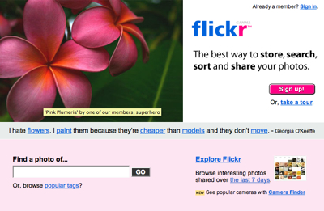

Image and video hosting website, web services suite, and online community platform.
The best way to store, search, sort and share your photos.

Slide 25
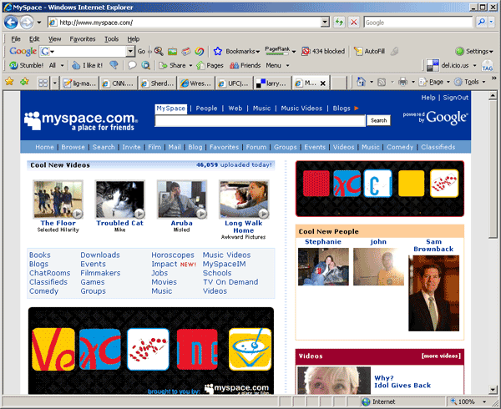

MySpace has over 40 billion page views monthly.
MySpace is available in 15 different languages.
MySpace was bought from the parent company of fox broadcasting for $580 million.
Google signed a $900 million deal to have their name advertised throughout MySpace.

Slide 26
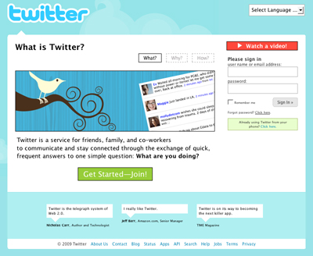

Fast growing micro-blogging platform.

Slide 27


Comprehensive mash up of various services.
One of the top searches on smart.
YM is the leading IM service worldwide.

Slide 28
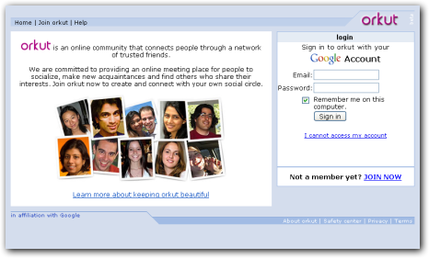

Designed to help users meet new friends and maintain existing relationships.

Slide 29
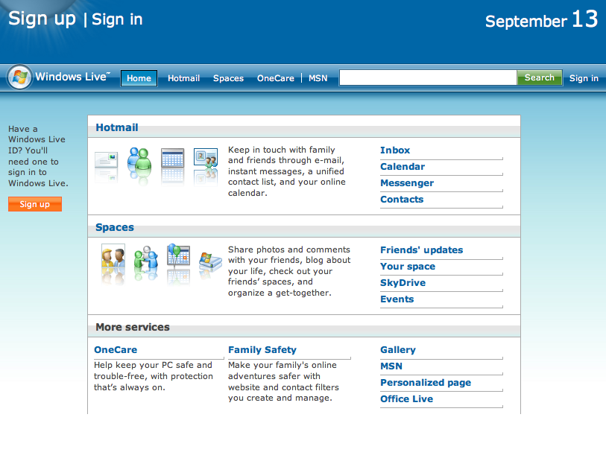

Live Search search engine,
The windows live Messenger
Instant messaging client.

Slide 30


Slide 31


Slide 32

GLOBALLY , SNS ARE GROWING FAST..!
SNS USER
YAHOO 505M
MYSPACE 117M
FACEBOOOK 132M
HI5 56M
FRIENDSTER 37M

Slide 33


96% of students who have access to the internet, are associated with social networking. This includes chatting, texting, messaging, and online communities. Two well known online communities are Facebook and MySpace.
50% of those student’s talk about school and homework when they are online.

Slide 34

66% of teens on social networking sites use privacy controls on their profiles. [10]
39% of kids have posted something on their social networking pages that they later regret.
[10]
22% of teen agers have posted their families photos of themselves online. [10]
15% of teens report that they've had private material (IMs, texts, emails) forwarded without permission. [10]

Slide 35
MARKETING:
Changing the way we market Social Networks will more become involved meaningful.
PUBLIC RELATIONS
ADVERTISING
RETAIL
COSTUMER SERVICE

Slide 36

Looking for friends and family
find a partner
be updated on events / trends / happenings
build their network
entertainment
shopping
marketing
build community
to learn

Slide 37

likely places for not identity theft and fraud.
As you have to provide certain information such as your e-mail address, name, and location, others use these information and pretend to be you, especially when they are into illegal activities.
Furthermore, someone pretending to be somebody else can make you believe that he or she is up to some business offer, ask to meet up with you, and take your money. It has also become easier for someone to stalk you and harass you online.
You should make use of the pros and cons of social networking sites to take precautions in the kind of people you should trust and share some information about yourself to. The debates whether you should or should not be a part of the social networking community is never ending. And, at the end of the day, the best weapon that you have is sound judgment.

Slide 38

Social networking sites have paved the way for easier communication to your friends, family, or colleagues.
discuss a school activity by having a conference in a certain site that you are all members of, thus saving you time and effort.
Virtual communities are also formed, which are composed of people connected together by common interests, purpose, and goal.
People of different races also get to mingle with each other in just a few clicks.

Slide 39

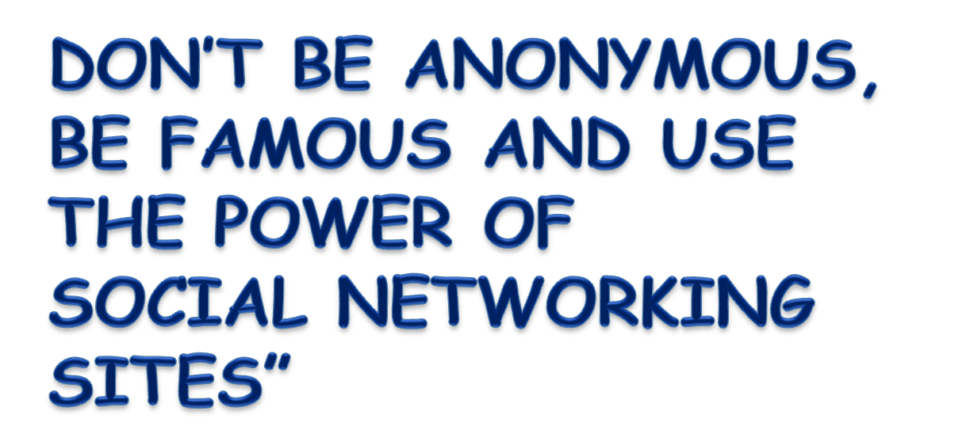

Slide 40


